Slide 1
Page layout
Christopher Harrison
@geektrainer
Content Developer
Microsoft

Slide 2
Bootstrap classes

Slide 3
Bootstrap classes
“Call” Bootstrap components
Three common starting classes
container
Creates a “fixed width” container
container-fluid
Container will always be the width of the browser
jumbotron
Used to create title sections

Slide 4
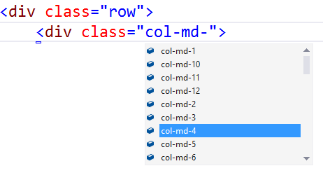
Visual Studio – Class IntelliSense

Slide 5
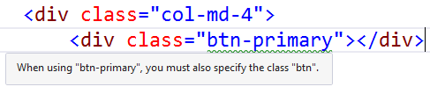
Visual Studio – Missing Class Detection

Slide 6
Bootstrap snippets
Snippets are an “enhanced copy/paste”
Simplify typing out blocks of code
Accessed by:
Right click > Insert Snippet
Ctl-K, Ctl-X
Snippets are available for Bootstrap
GitHub project by Eric Lebetsamer
https://github.com/elebetsamer

Slide 7
Visual Studio Support

Slide 8
Bootstrap Grid

Slide 9
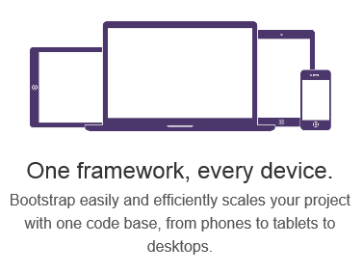
Responsive Layout

Slide 10
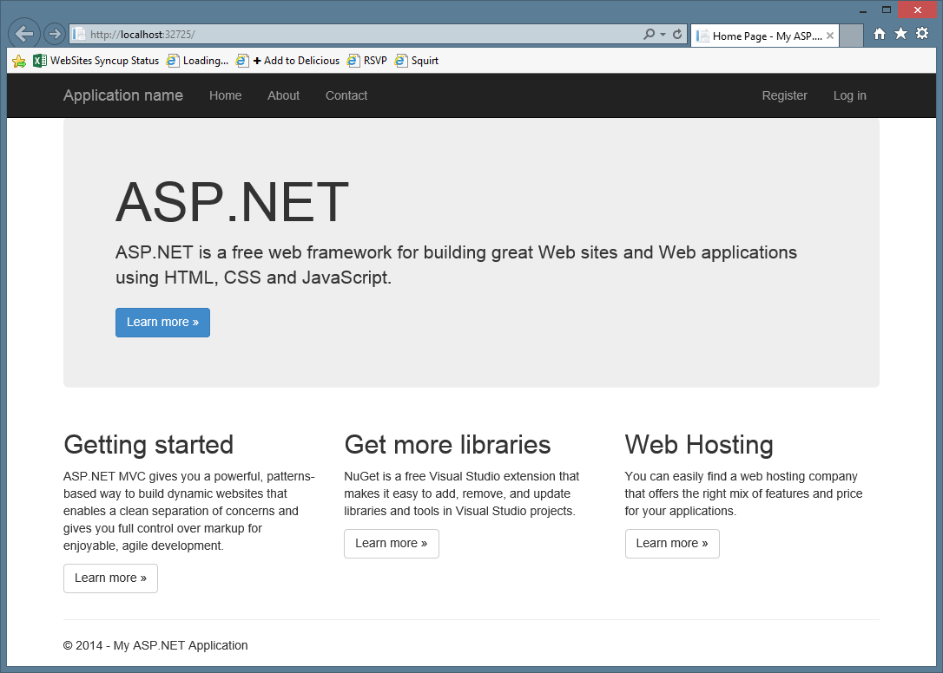
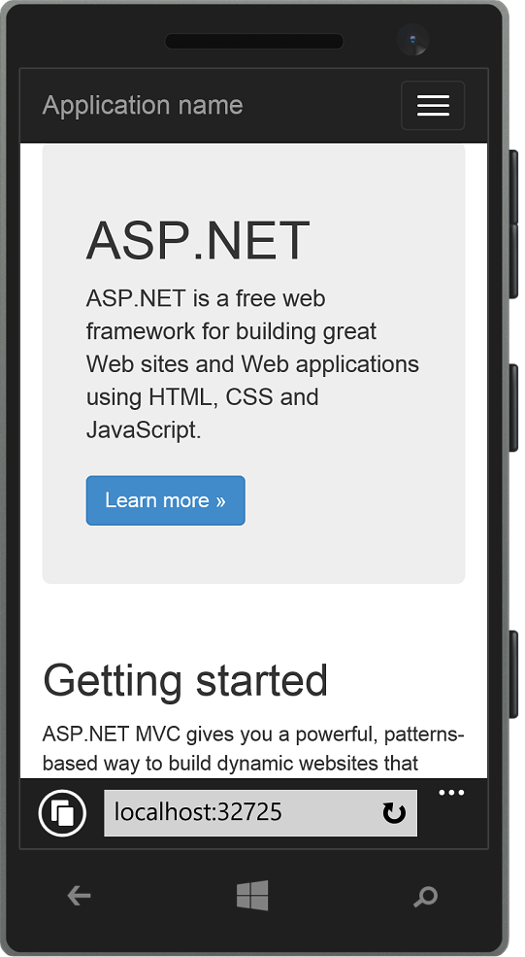
Responsive Layout

Slide 11
Site Design
Banner
Cover Art
Title
Artist
Bio
Expert Review
Track
Track
Track
Track
Track
Time
Time
Time
Time
Time

Slide 12
Bootstrap Grid
Bootstrap works on a grid
The grid has 12 columns
There are four grids
One grid for each screen size
Large (1200px and higher)
Medium (992px-1200px)
Small (768px-991px)
Extra small (less than 768px)

Slide 13
Bootstrap Grid
Large
Medium
Small
Extra Small

Slide 14
Column classes
Identified with three parts
col
Indicates column
Grid size
lg, md, sm, xs
Each size applies to itself and larger, unless overridden
sm applies to Small, Medium and Large
Number of columns

Slide 15
Examples
col-lg-6
Applies to large (>1200px)
Takes up 6 columns
col-md-4
Applies to medium (992px-1200px)
Takes up 4 columns
col-sm-12
Applies to small (768px-991px)
Takes up 12 columns (the entire row)

Slide 16
Grid system
 | Extra small devices Phones (<768px) | Small devices Tablets (≥768px) | Medium devices Desktops (≥992px) | Large devices Desktops (≥1200px)
Grid behavior | Horizontal at all times | Collapsed to start, horizontal above breakpoints
Container width | None (auto) | 750px | 970px | 1170px
Class prefix | .col-xs- | .col-sm- | .col-md- | .col-lg-
Column width | Auto | 60px | 78px | 95px
Gutter width | 30px (15px on each side of a column)
Always 12 columns

Slide 17
Site Design
Banner
Cover Art
Title
Artist
Bio
Expert Review
Track
Track
Track
Track
Track
Time
Time
Time
Time
Time

Slide 18
Page Layouts

